Slide 1
MODIFIERS
There are four types of Java access modifiers:
Private: The access level of a private modifier is only within the class. It cannot be accessed from outside the class.
Default: The access level of a default modifier is only within the package. It cannot be accessed from outside the package. If you do not specify any access level, it will be the default.
Protected: The access level of a protected modifier is within the package and outside the package through inheritance only. If you do not make the child class, it cannot be accessed from outside the package.
Public: The access level of a public modifier is everywhere. It can be accessed from within the class, outside the class, within the package and outside the package.

Slide 2
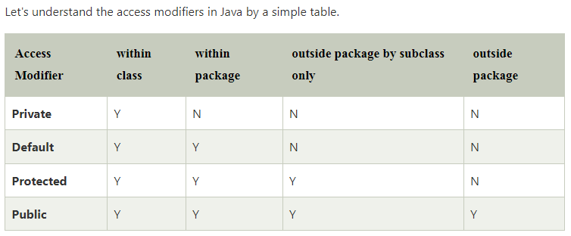

Slide 3
Private Example
class A{
private int data=40;
private void msg(){
System.out.println("Hello java");
}
}
public class Simple{
public static void main(String args[]){
A obj=new A();
System.out.println(obj.data); //Compile Time Error
obj.msg(); //Compile Time Error
}
}

Slide 4
Default Example
If you don't use any modifier, it is treated as default by default. The default modifier is accessible only within package. It cannot be accessed from outside the package. It provides more accessibility than private. But, it is more restrictive than protected, and public.
//save by A.java
package pack;
class A{
void msg(){System.out.println("Hello");}
}
//save by B.java
package mypack;
import pack.*;
class B{
public static void main(String args[]){
A obj = new A(); //Compile Time Error
obj.msg(); //Compile Time Error
}
}

Slide 5
Protected
The protected access modifier is accessible within package and outside the package but through inheritance only.
The protected access modifier can be applied on the data member, method and constructor. It can't be applied on the class.
It provides more accessibility than the default modifier.
//save by A.java
package pack;
public class A{
protected void msg(){
System.out.println("Hello");
}
}
------------------------------------------
//save by B.java
package mypack;
import pack.*;
class B extends A{
public static void main(String args[]){
B obj = new B();
obj.msg();
}
}

Slide 6
Public
The public access modifier is accessible everywhere. It has the widest scope among all other modifiers.
//save by A.java
package pack;
public class A{
public void msg(){System.out.println("Hello");
}
}
----------------------------------------------------
//save by B.java
package mypack;
import pack.*;
class B{
public static void main(String args[]){
A obj = new A();
obj.msg();
}
}

Slide 7
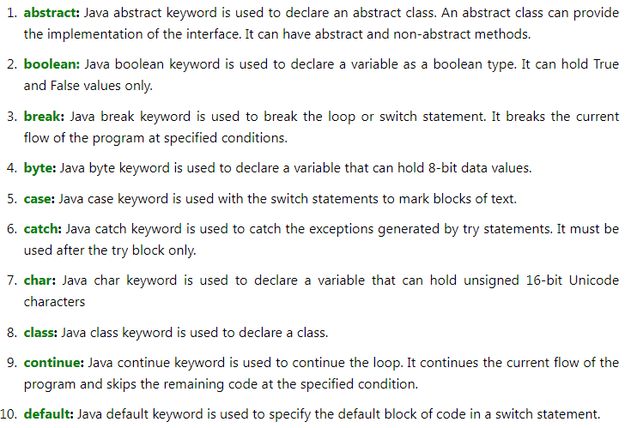
List of Java Keywords

Slide 8
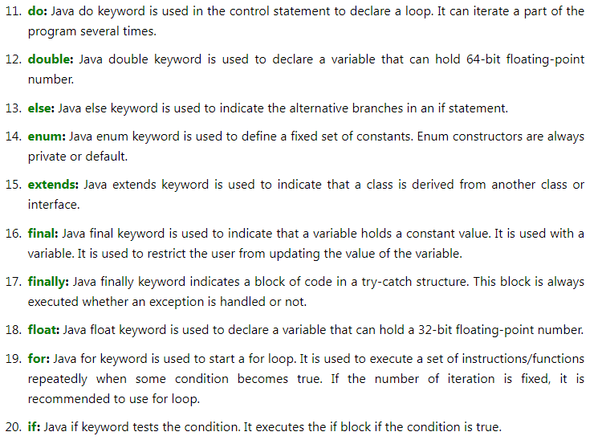

Slide 9
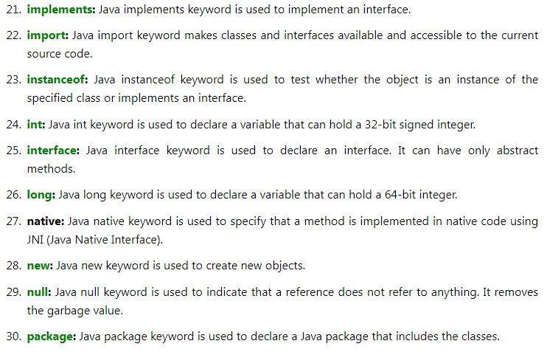

Slide 10
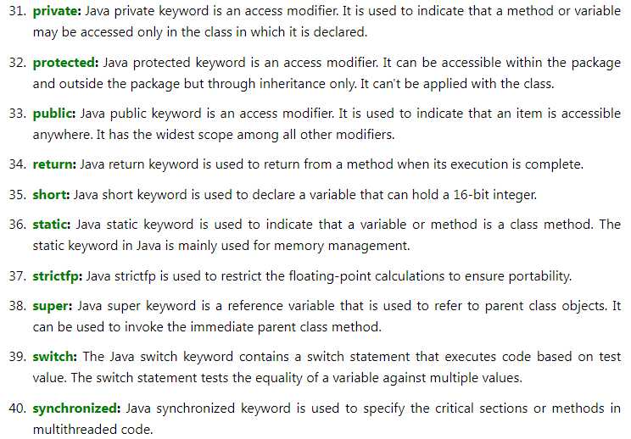

Slide 11
